Slide 1
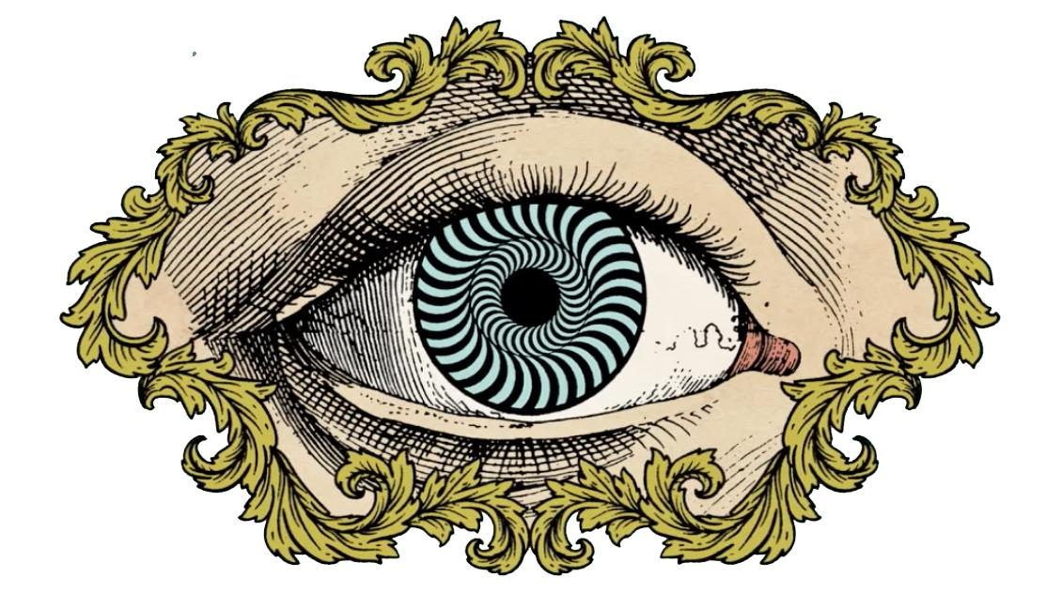
Illusion Project:

Slide 2
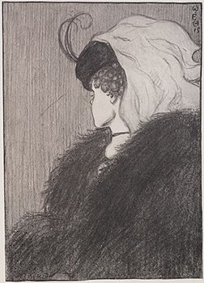
Conflicting Appearance
What does this drawing look like?
Can you see something else?
Notes:
The image can appear to be a young lady in a hat facing away from the viewer OR and old woman with a large nose

Slide 3
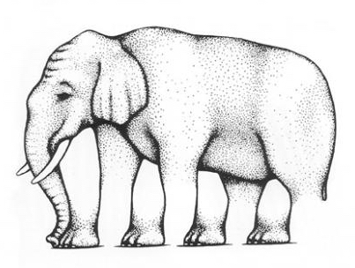
What is an optical illusion?
An optical illusion is seeing something that does not exist or that is different than it appears to be.
Some people find the illusion too hard to look at - it is too disconnected from reality.
How many legs does this elephant have?

Slide 4
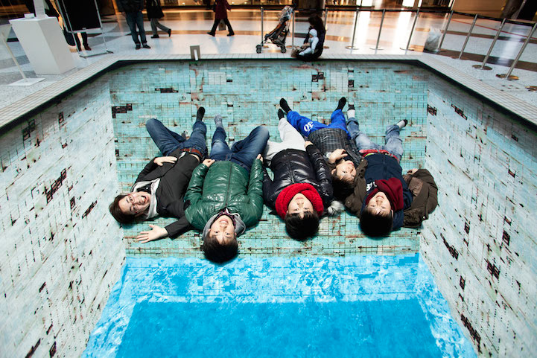
How do optical illusions work?
There are three types of optical illusions:
1. Physiological effects from excess stimulation (brightness, color, size, position, movement)
2. Cognitive effects in which eyes “fill in” missing or incomplete data
3. Images that appear to differ from the objects that make them.
Ex) MC Escher

Slide 5
Physiological illusions
Count how many black dots….
Notes:
There are no black dots in this image - it’s the contrasting values trick our brain and we see shadow dots

Slide 6
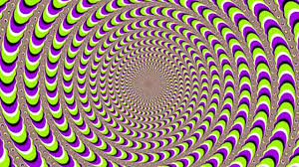
Cognitive illusions
Notes:
The lines are straight

Slide 7
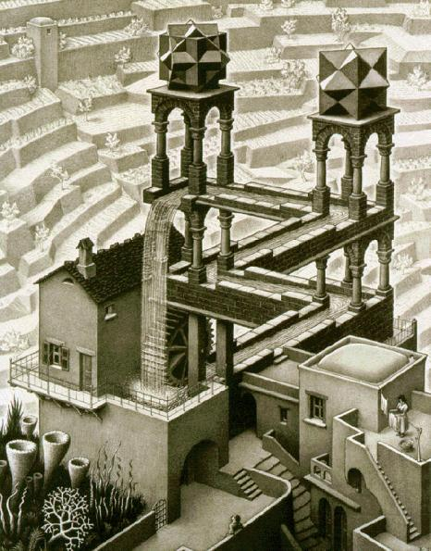
Type 3
Ex: The work of M.C. Escher…
But did you know that he uses mathematical concepts (Euclidean geometry, hyperbolic geometry, tessellations) in his drawings despite having no formal mathematical training or a high school diploma?
Notes:
M.C. Escher

Slide 8
Choose 2 of the 3 options :
Photoshop or Camera Requirements:
-Use of at least 1 Filter or blending mode
-Replace at least one background
-Follow 3 DIFFERENT rules of composition
- 2 new edits from Illusion tutorials
Requirements:
-20+ photos turned in via contact sheet
-Minimum of 3 sketches INCLUDING LABELS and plans for edits
2-3 Final Photos- Choose 2!

Slide 9
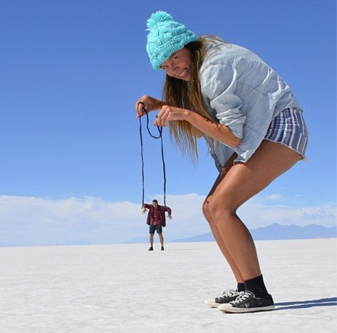
Option 1) Distorting or creating a new reality:
“Reality is simply a matter of perception”
Mess with proportions of objects to create your own fantasy scene
Always follow the rules of composition
Use children’s books and movies as a reference for these photos

Slide 10
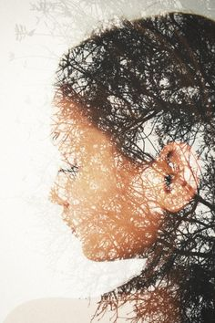
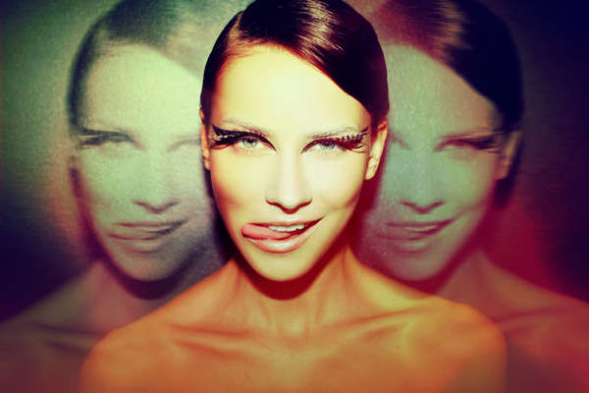

Slide 11
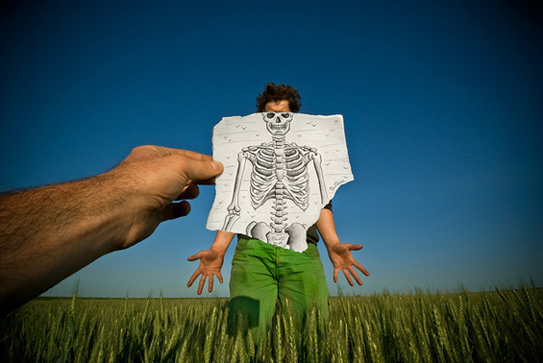

Slide 12
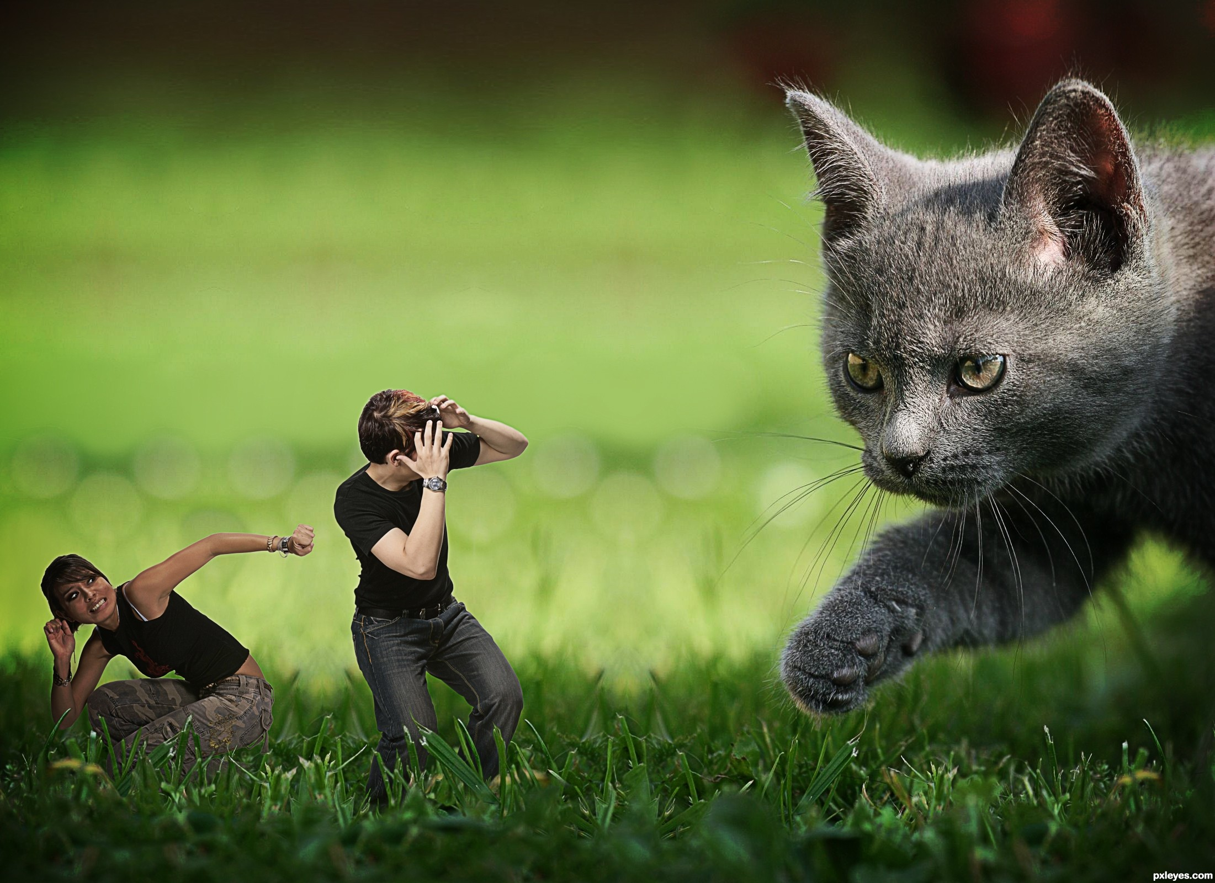
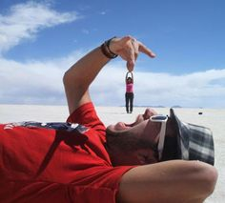

Slide 13
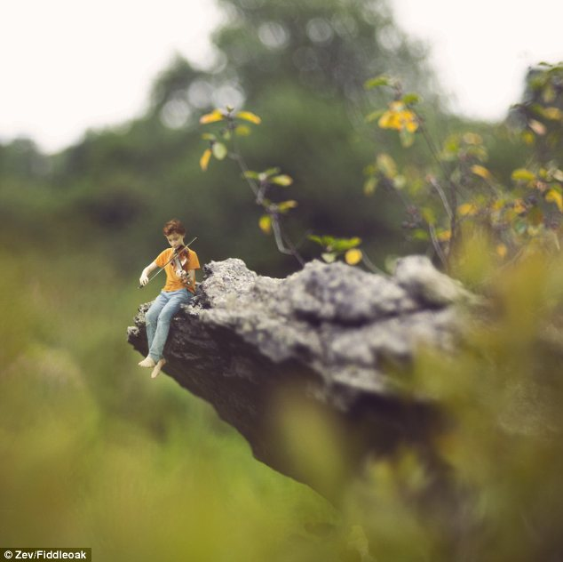

Slide 14
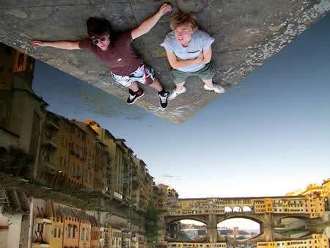
Type 2) This photo should show a message or lesson…this could be a misconception in society that needs to be corrected.
Example; putting work before your family

Slide 15
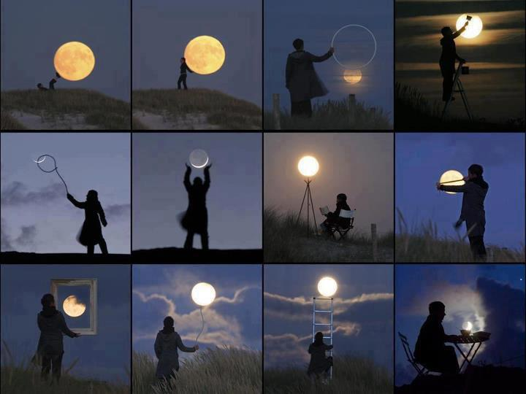

Slide 16
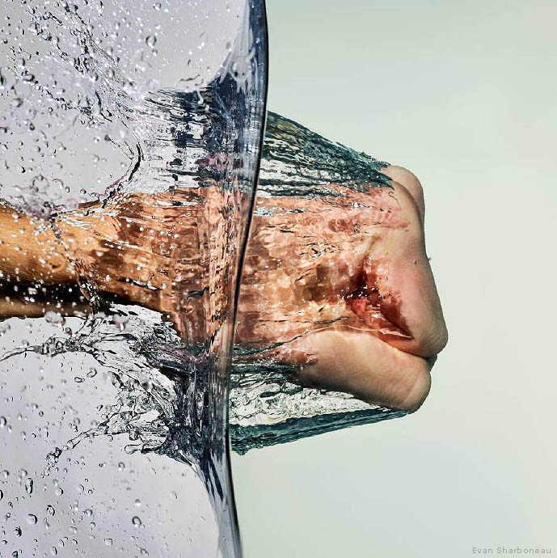
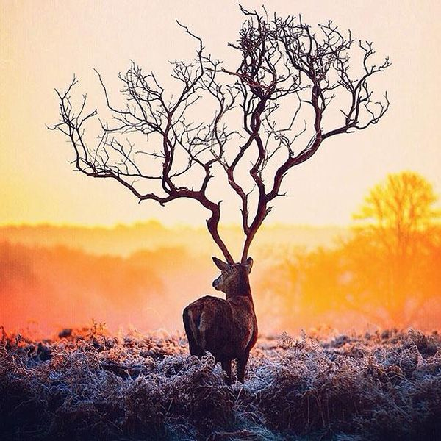

Slide 17
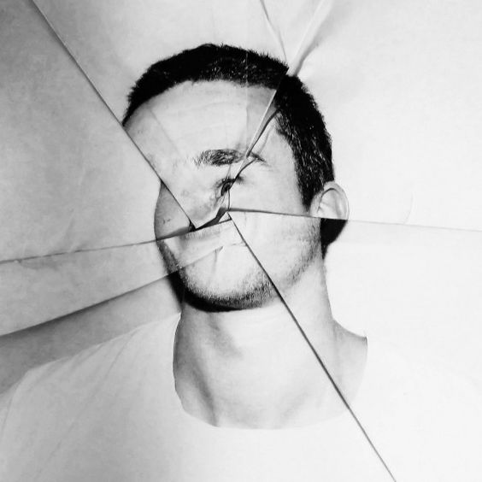
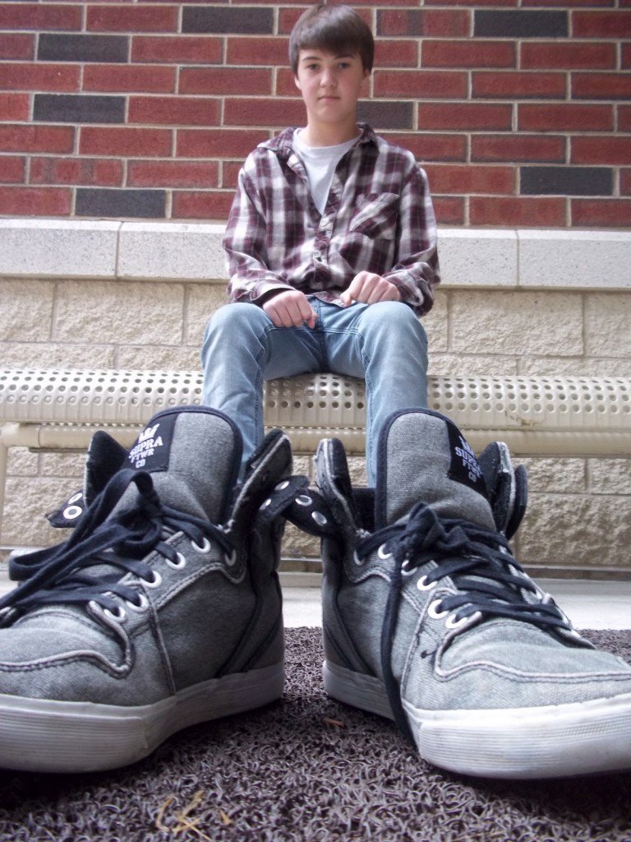

Slide 18
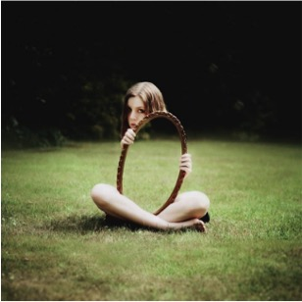
Type 3) This photo should take on a challenging illusion in Photoshop AND convey a message about society’s perception.
This is a combination of the two types above and should be attempted by students willing to challenge themselves.

Slide 19
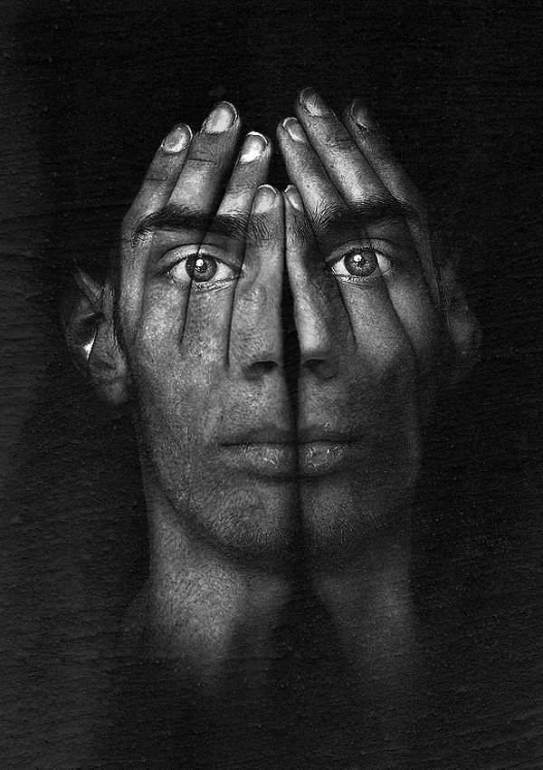
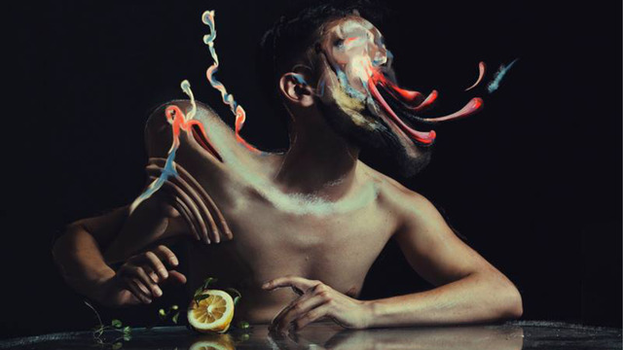

Slide 20
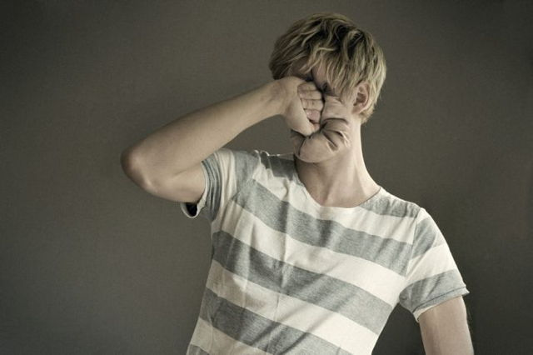

Slide 21
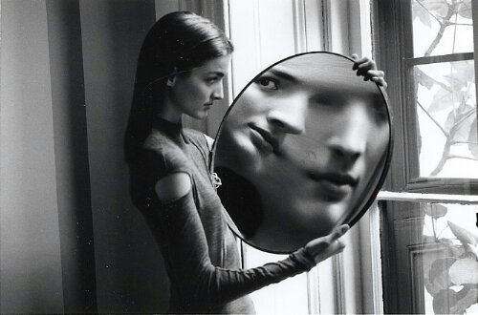
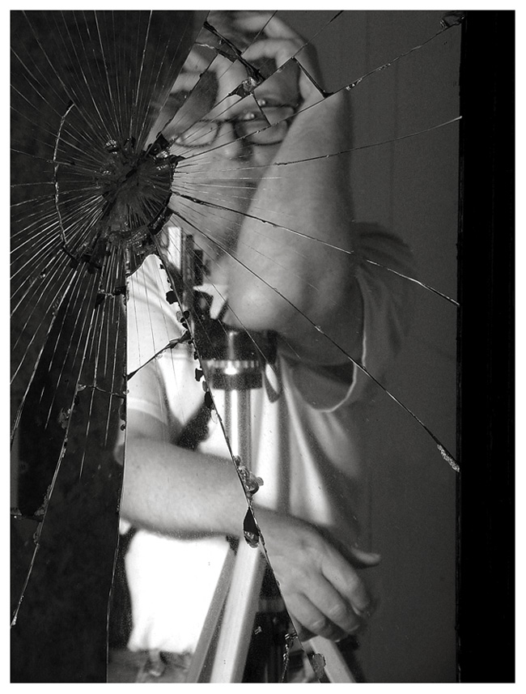

Slide 22
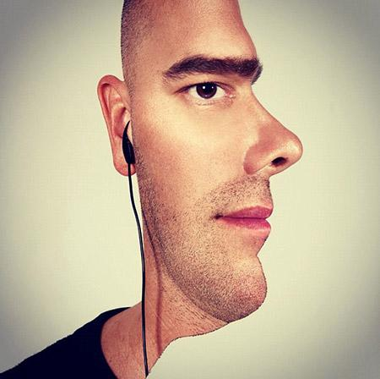
QUESTIONS?

Slide 23
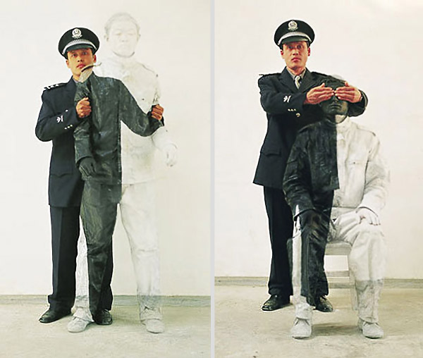

Slide 24
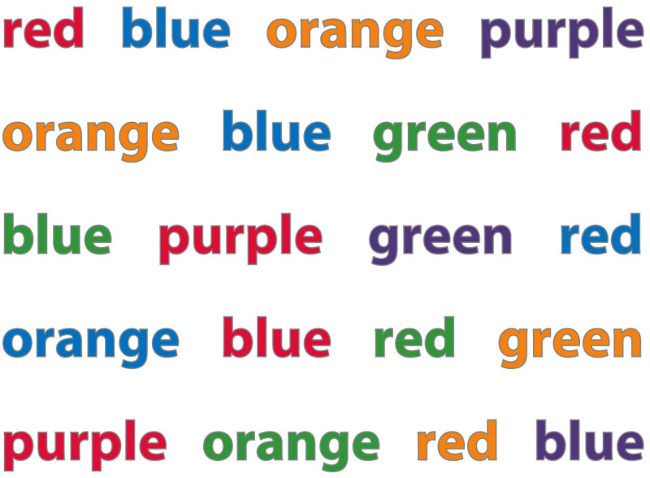
Try this game!
http://channel.nationalgeographic.com/brain-games/interactives/reading-in-color/

